Slide 1

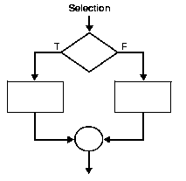

Selection/Conditional Flowchart and Pseudocode

Slide 2
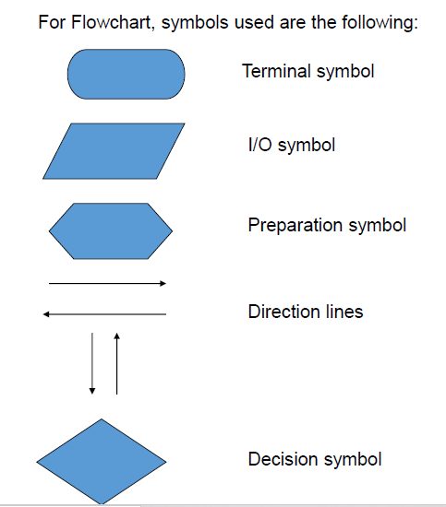
Notes:
Decision shape is represented as a Diamond. This object is always used in a process flow to ask a question. And, the answer to the question determines the arrows coming out of the Diamond.

Slide 3
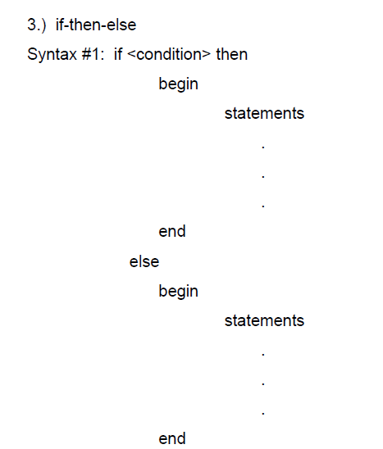
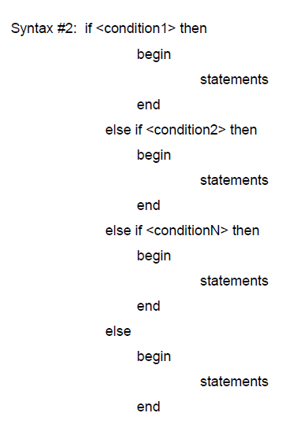

Slide 4
Selection/Conditional Structure
Create a flowchart and a pseudocode that would input an integer number and then indicate whether the number is an even or an odd number.

Slide 5
Selection/Conditional Structure
Workers at Kookaburra Factory have a regular working hours of 40 hours per week and are paid Php 50.00 per hour. However, if the workers rendered more than 40 hours per week, the excess hours are paid 75% more. Create a flowchart and a pseudocode that would input the number of hours rendered by a worker in one week and output his net salary.

Slide 6
Selection/Conditional Structure
The fine for an over-speeding violation depends on the speed of the erring driver, as follows:
60 to 75 mph = Php 2000.00
76 mph and above = Php 4000.00
Create a flowchart and a pseudocode to input the car’s speed and then output the fine, if any.

